Slide 1

School Guide in Navigating the Tool
Finance Service Center
Monday - Friday
8:00AM – 5:00PM
(718) 935 - 5000
ClientServices@schools.nyc.gov
Division of Contracts and Purchasing
David Ross, Executive Director
Susan Dick McKeon, Chief Administrator
Joy Gentolia, Director
http://schools.nyc.gov/Offices/DCP

Slide 2
OVERVIEW
Purpose
MTACs Have Distinct Advantages
MTAC Selection Process
MTAC Thresholds
Using the MTAC Selection Tool
MTAC Plus School Guide

Slide 3
Purpose
  Used to procure services when there is high demand for a type of service (such as professional development in a specific field) and when we want to offer a choice among multiple providers of the service.
  Contracts are awarded to every provider who meets the requirements of the solicitation.

Slide 4
MTACs Have Distinct Advantages
Why use MTAC contracts?
  Listed vendors have been screened/prequalified.
  There are many vendors to choose from.
  Listed vendors have DOE contracts, so there’s quick access to services.
  Used appropriately, they meet our legal requirements for competition to assure “best value.”

Slide 5
MTAC
No. of contracts: 535 MTAC Solicitations: 23 Annual Spend: About $106 million
Direct Student Services: College/Post-Secondary Planning Science & STEM Arts Education Services Social Studies Leadership Development & Civic Engagement Individual & Group Counseling Mentoring Recreation & Sports Bullying Prevention Violence Prevention/Student Safety School Attendance Improvement Academic Skills Enhancement Family Literacy Substance Abuse & Intervention Thematic Projects Expanded Learning Time Career & Technical Education Services | Professional Development Services: Special Education Science & STEM Math Social Studies Arts English Language Learners School Leaders & Teachers System-wide program evaluation services Instructional Technology Services to promote safe and supportive schools

Slide 6
MTAC Selection Process
Services under $25K require no competition. Services over $25K require some level of review/competition.
The level of spending drives the numbers of proposals and committee members required.
For each MTAC task request, a minimum number of vendors is required to respond. If the minimum number of responses is not received, the system will re-release to additional vendors.

Slide 7
MTAC Thresholds
MTAC Threshold | Vendor(s) (Minimum) | Required # of Proposals (Minimum) | Committee Members (Minimum)
$0 - $25,000 | N/A | N/A | N/A
>$ 25,000 - $100,000 | 3 (School selects 1 -- MTAC system selects 2) | 2 | 1
>$100,000 - $250,000 | 5 (School selects 1 -- MTAC system selects 4) | 3 | 3
> $250,000 | All | 1 | 3

Slide 8
Using the MTAC Selection Tool
Scope of service should have adequate information for vendors to offer a
clear and complete response:
  Objective
    Identify needs that are specific to your school and its population.
    Tell where the school is located.
  Deliverables include grade level, # of students/teachers involved and other information that will assist vendors to submit a competitive response.
  Work tasks/Timeline – Include any specific tasks that are required and include day/frequency/duration of the services.
  Never refer to a specific vendor or vendor’s program.
  Negotiate with vendors to offer competitive pricing. Suggested discount off contract price.

Slide 9
Using the MTAC Selection Tool (cont.)
  Evaluation Committee
  # of Members based on the procurement threshold.
  Members are not permitted to report to or supervise another committee member.
  Select individuals that are familiar with the services needed.

Slide 10
MTAC Plus Tool
(School Step by Step Guide)

Slide 11
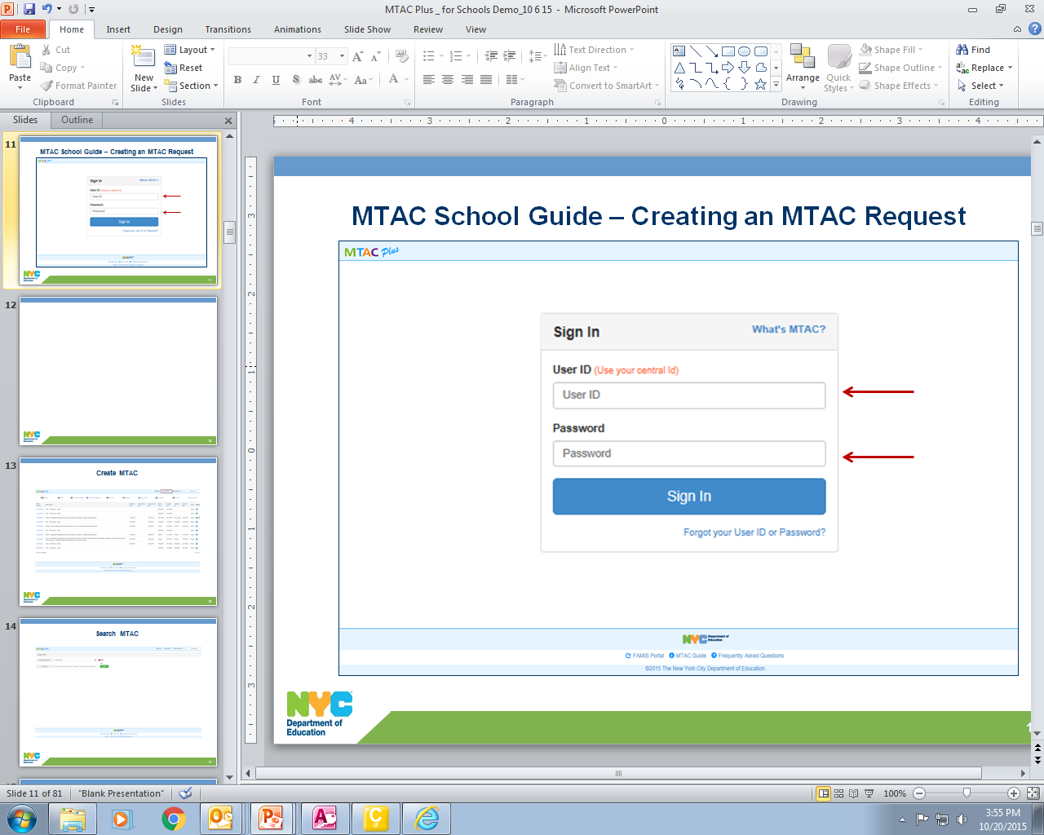
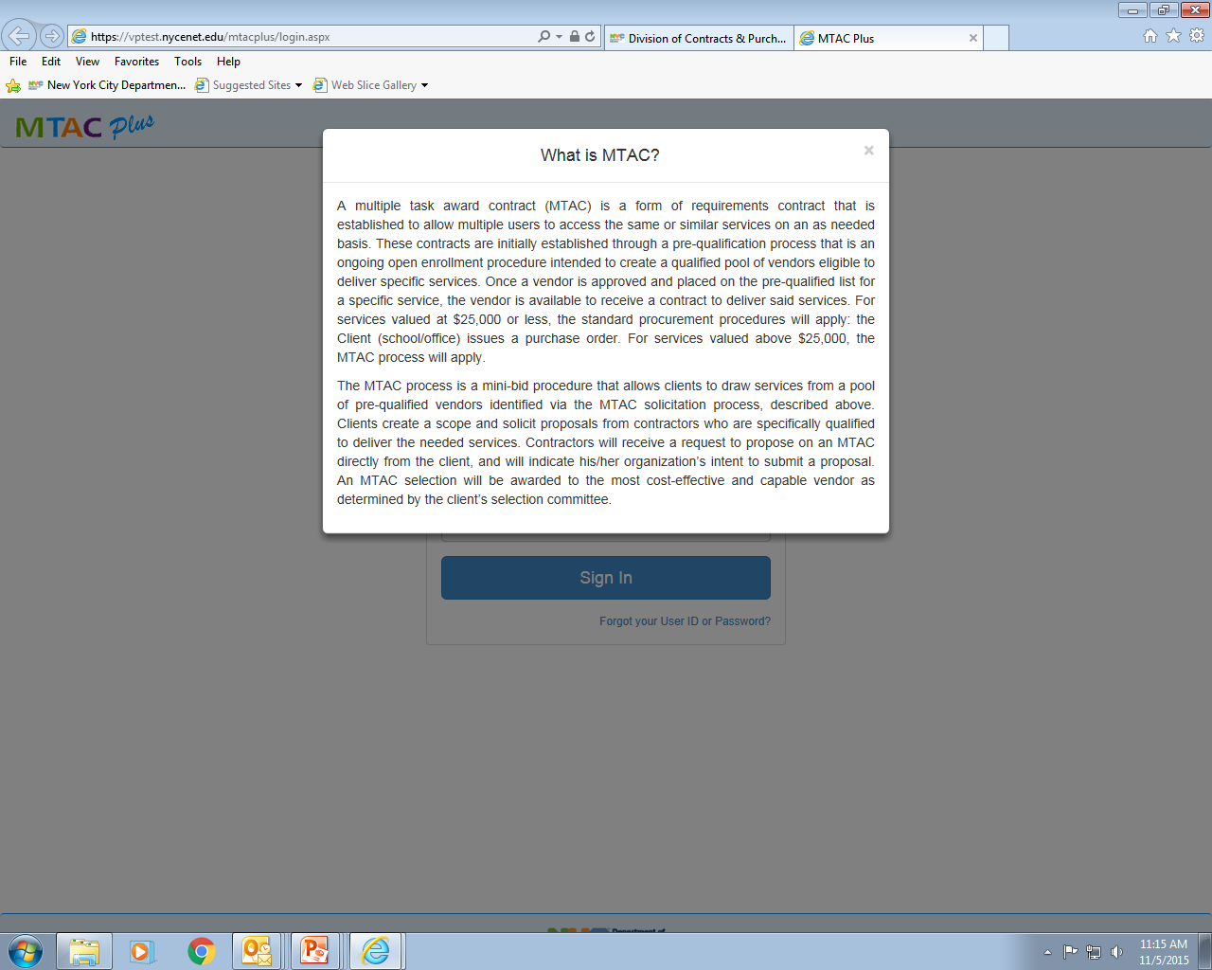
You can access the MTAC Plus via https://dfoapps.nycenet.edu/mtacplus/login.aspx. By clicking on “What’s MTAC” a description will be displayed.

Slide 12
Sign-in using your Outlook “User Id” and “Password”.

Slide 13
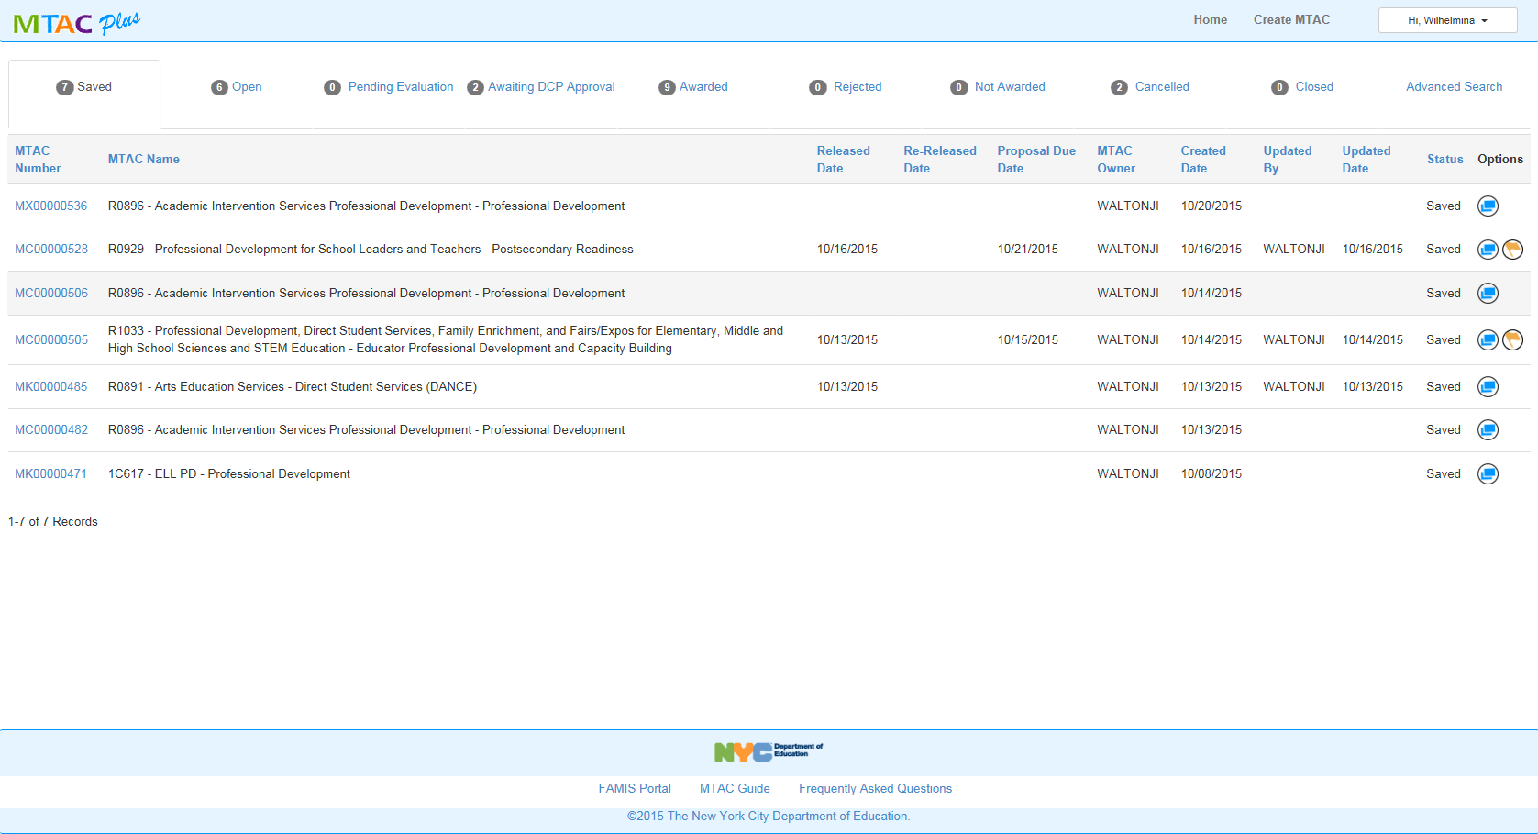
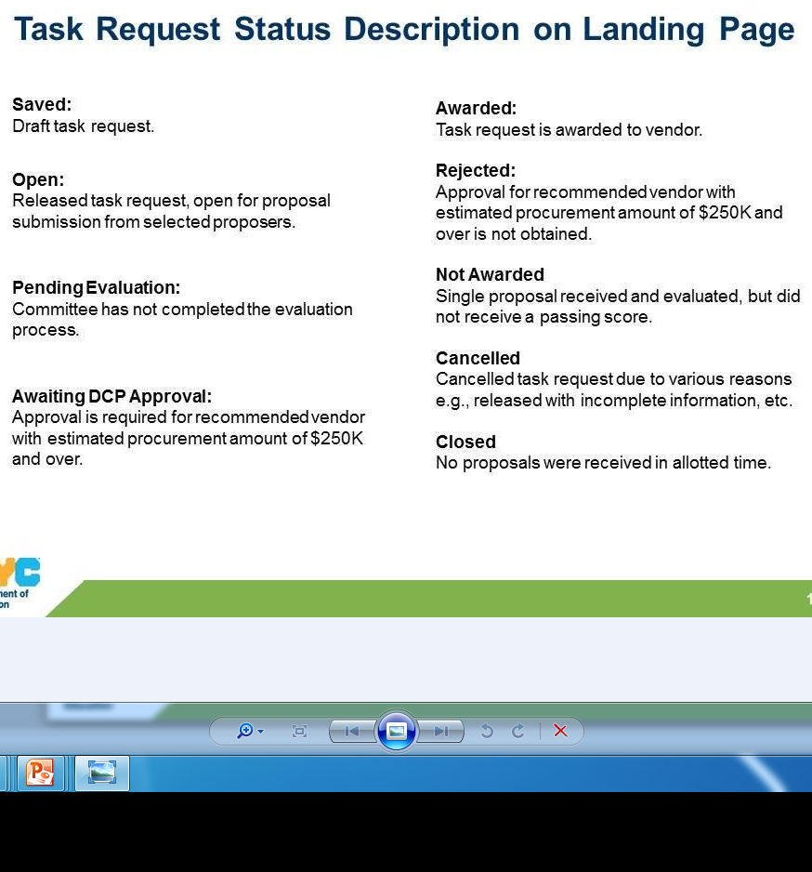
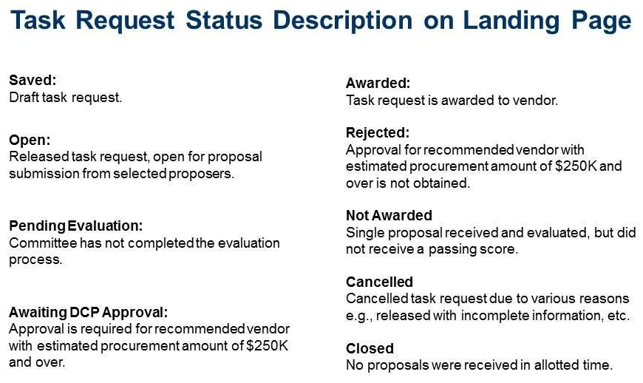
When you log in, you will be taken to your Landing Page. As the initiator/user, you will have the option to review or edit all existing task request(s) created under your User ID.

Slide 14
Click on the “Create MTAC” to develop a new task request.

Slide 15
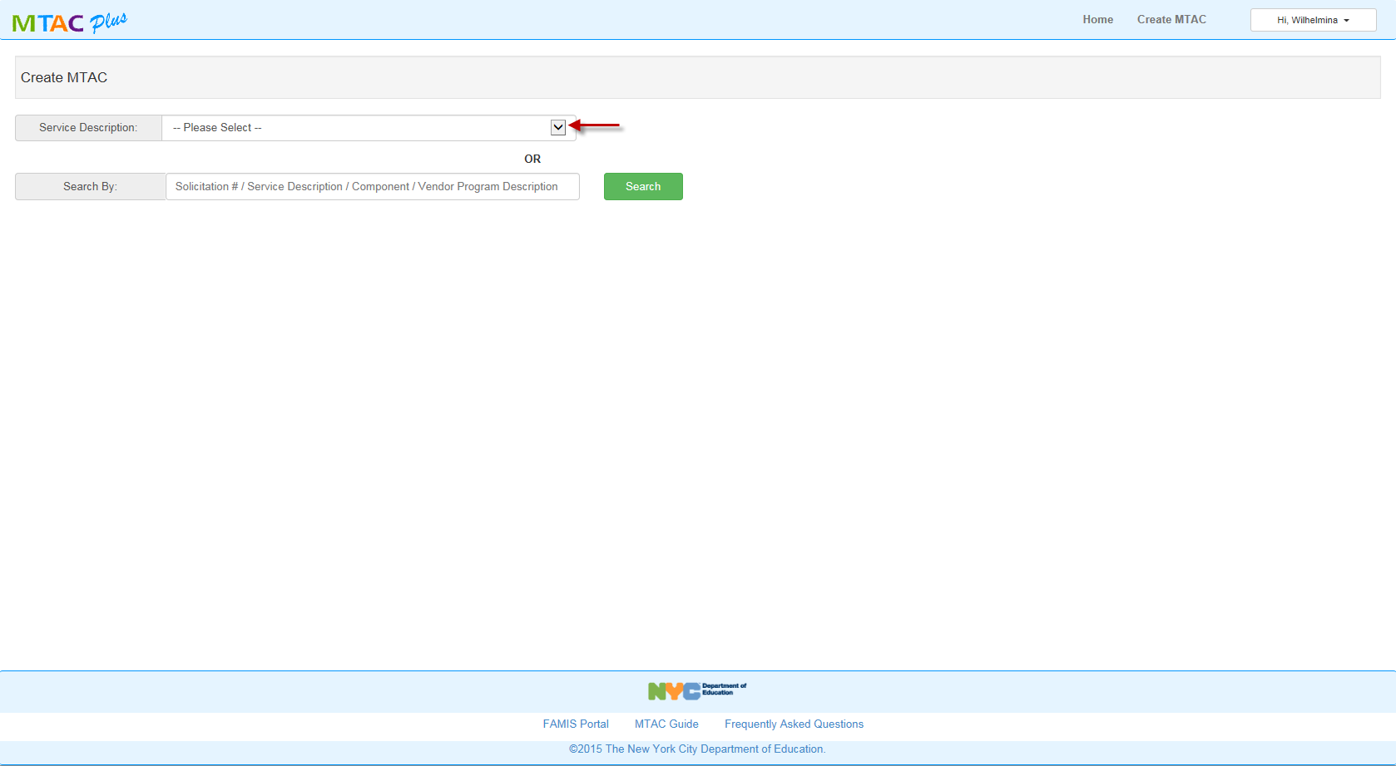
It will take you to the search page. The user will have the option to search via drop down on “Service Description” and “Component” or by entering text in the “Search By” field.

Slide 16
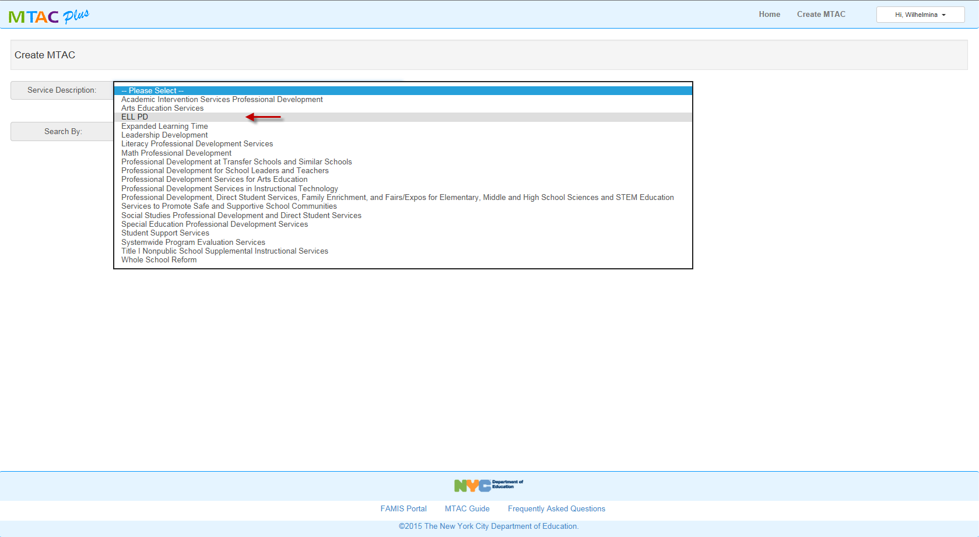
Here’s a sample of the drop down menu if you search by “Service Description”, let’s select ELL PD.

Slide 17
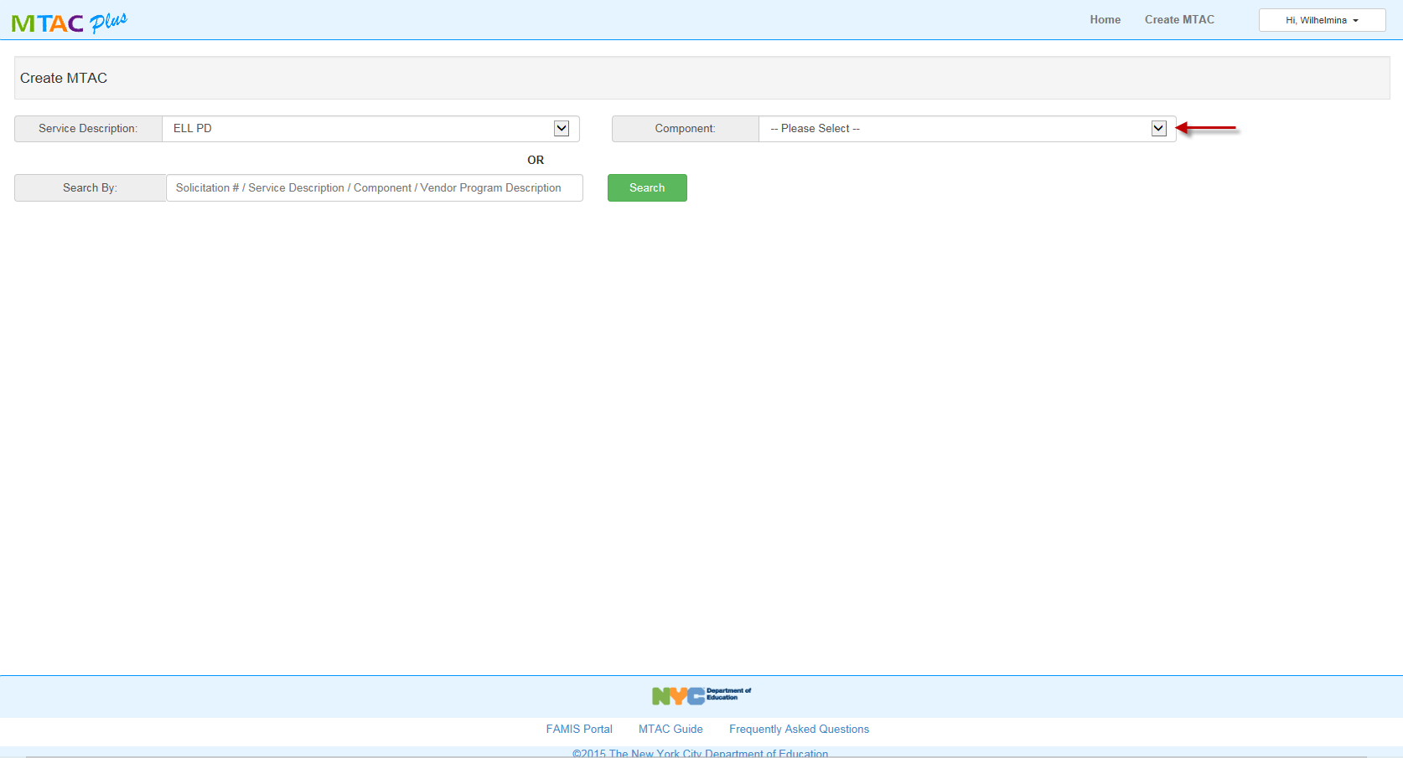
In selecting ELL PD from the “Service Description” field, it will prompt you to select from the Component drop down menu specific for ELL PD.

Slide 18
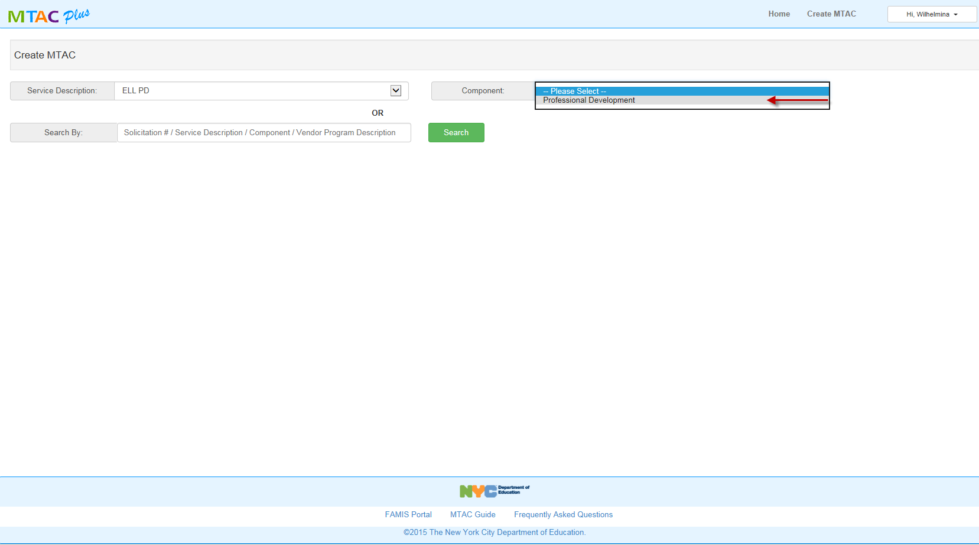
Let’s proceed to select the Component available for ELL PD, “Professional Development”.

Slide 19
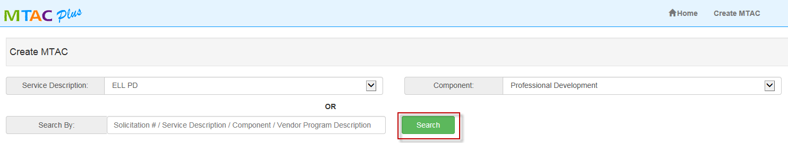
Click “Search” to get the list of eligible vendors for ELL PD.

Slide 20
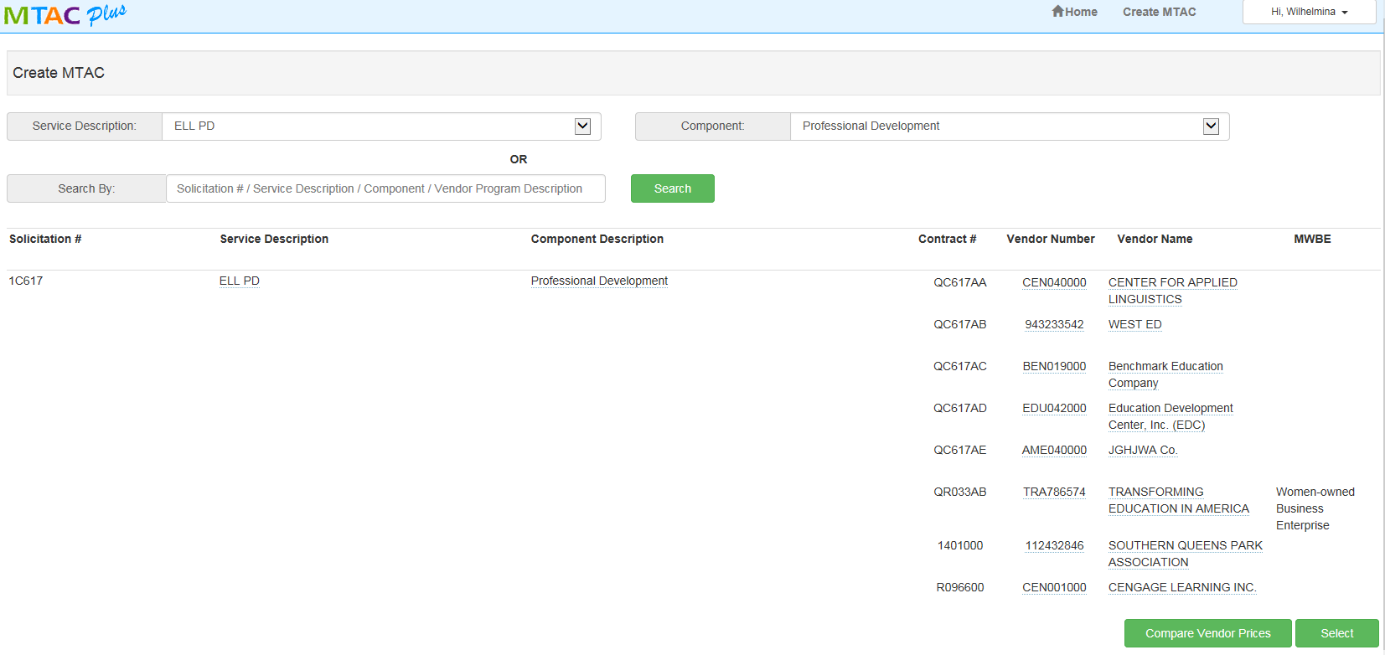
Upon clicking “Search”, the list of eligible vendors will be populated.

Slide 21
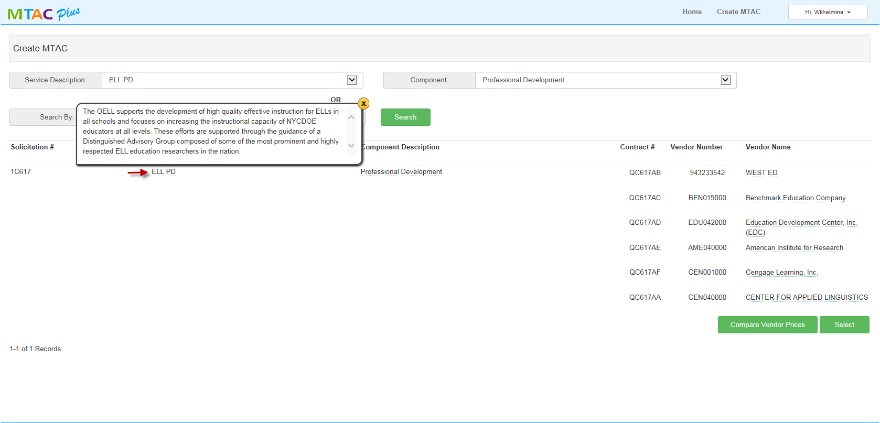
Tool tips are available where you see underlined items. This screen gives you the tool tip for “Service Description”.

Slide 22
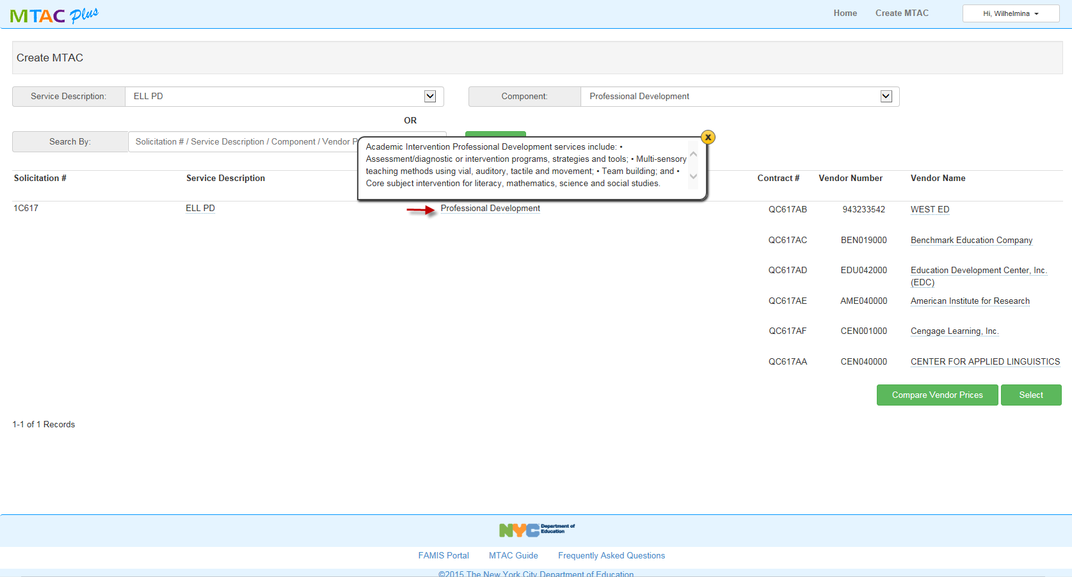
This screen gives you the tool tip for “Component Description”.

Slide 23
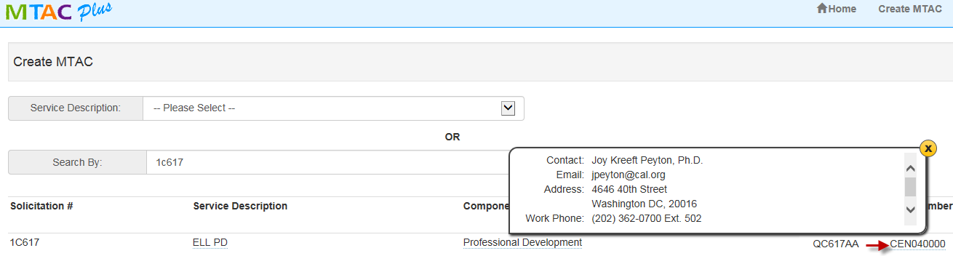
This screen gives you the tool tip for “Vendor Number”, which gives you the vendor contact information.

Slide 24
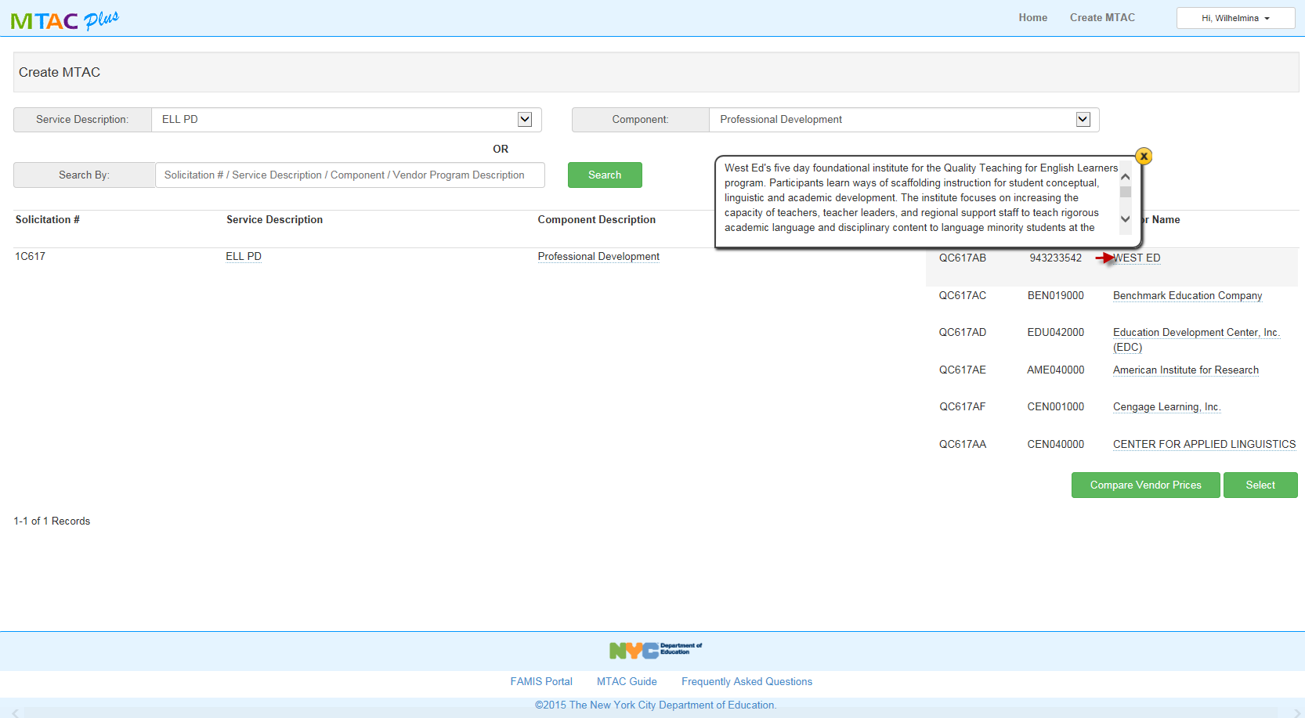
This screen gives you the tool tip for the Vendor’s Abstract.

Slide 25
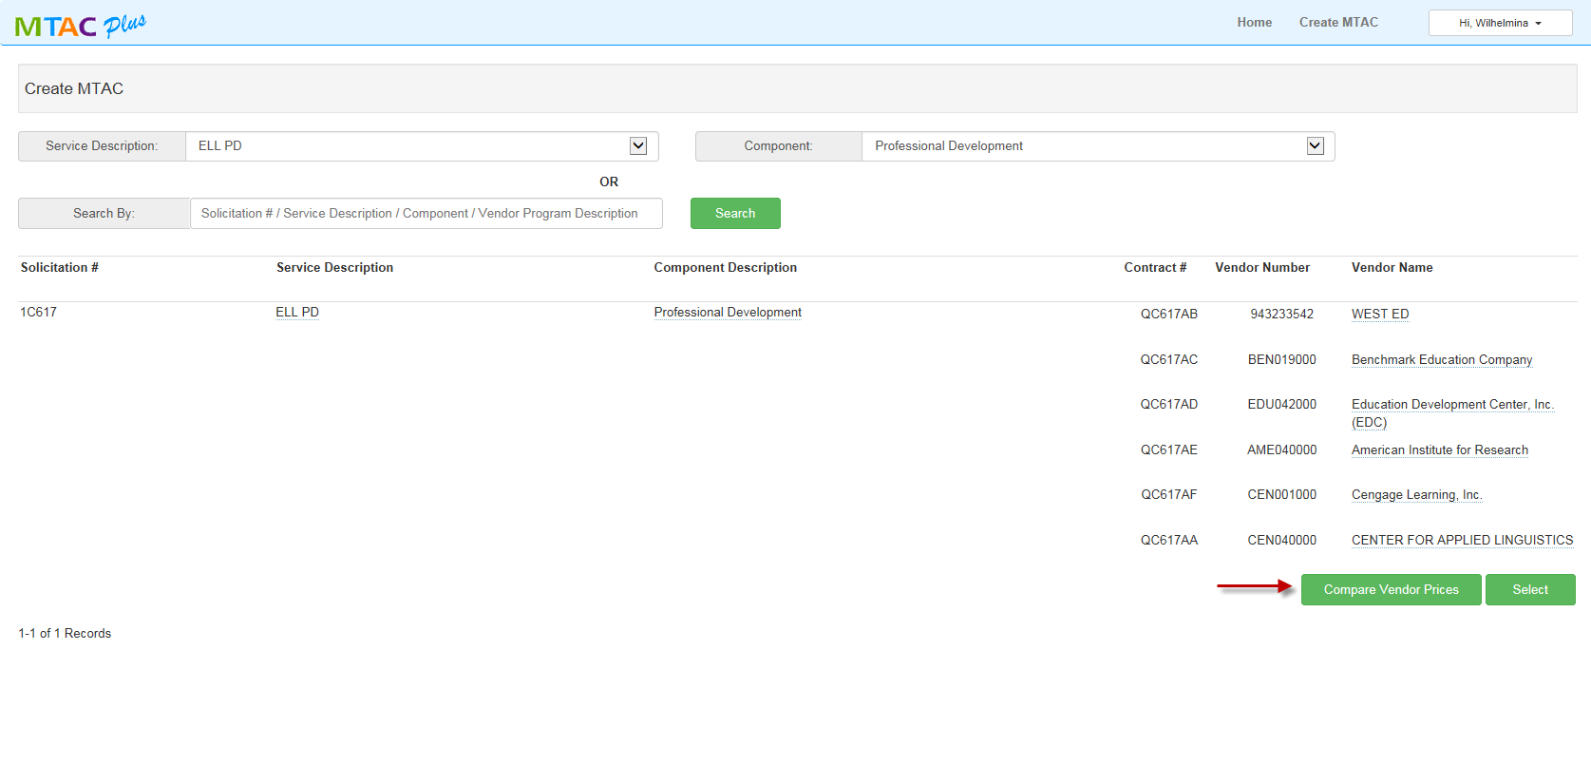
Here, the initiator can compare vendor prices by clicking “Compare Vendor Prices” button.

Slide 26
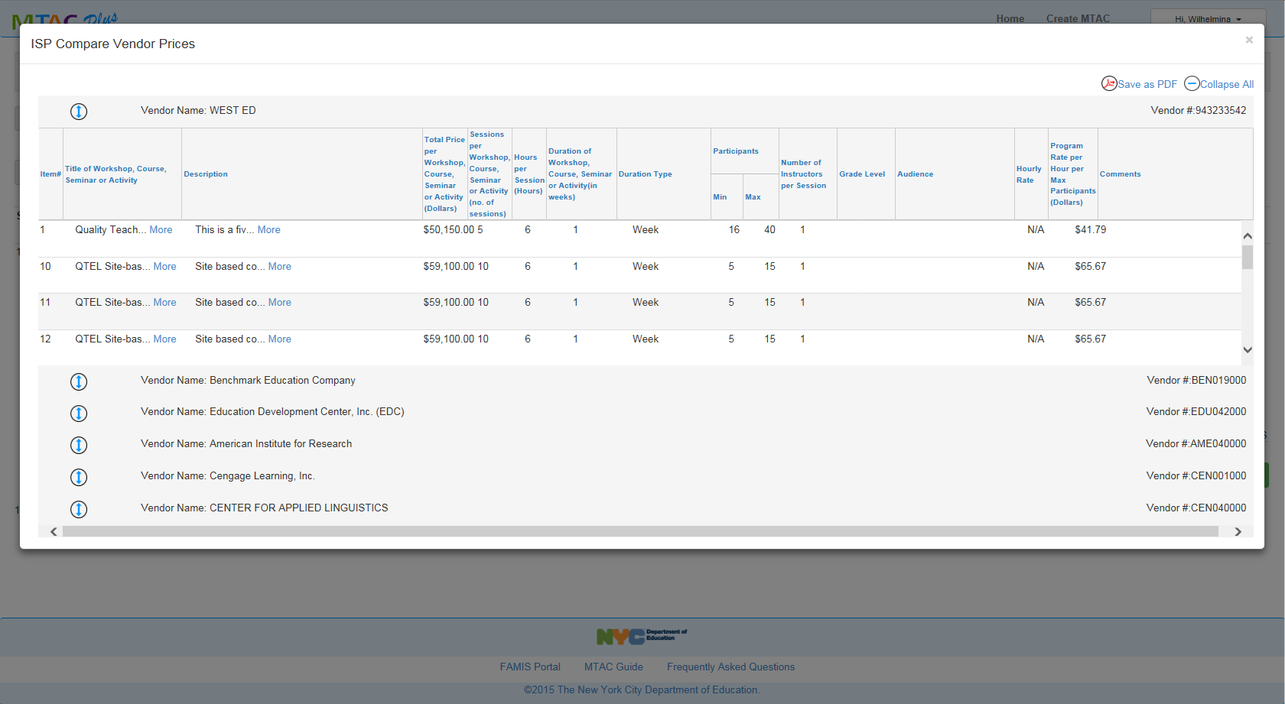
This is what you will get when you click on “Compare Vendor Prices”.

Slide 27
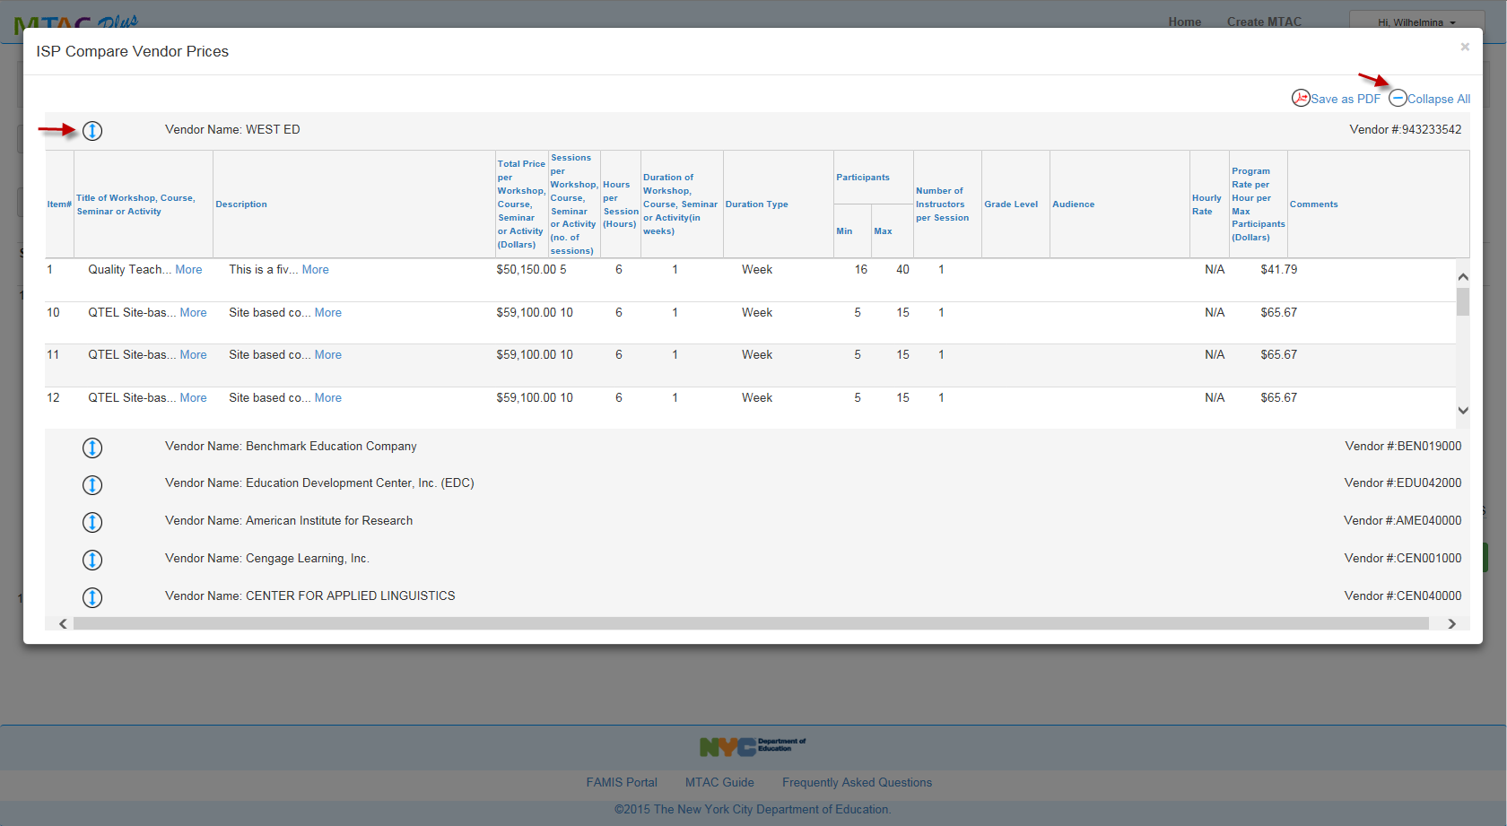
You can collapse all or collapse/expand each individual vendor price file.

Slide 28
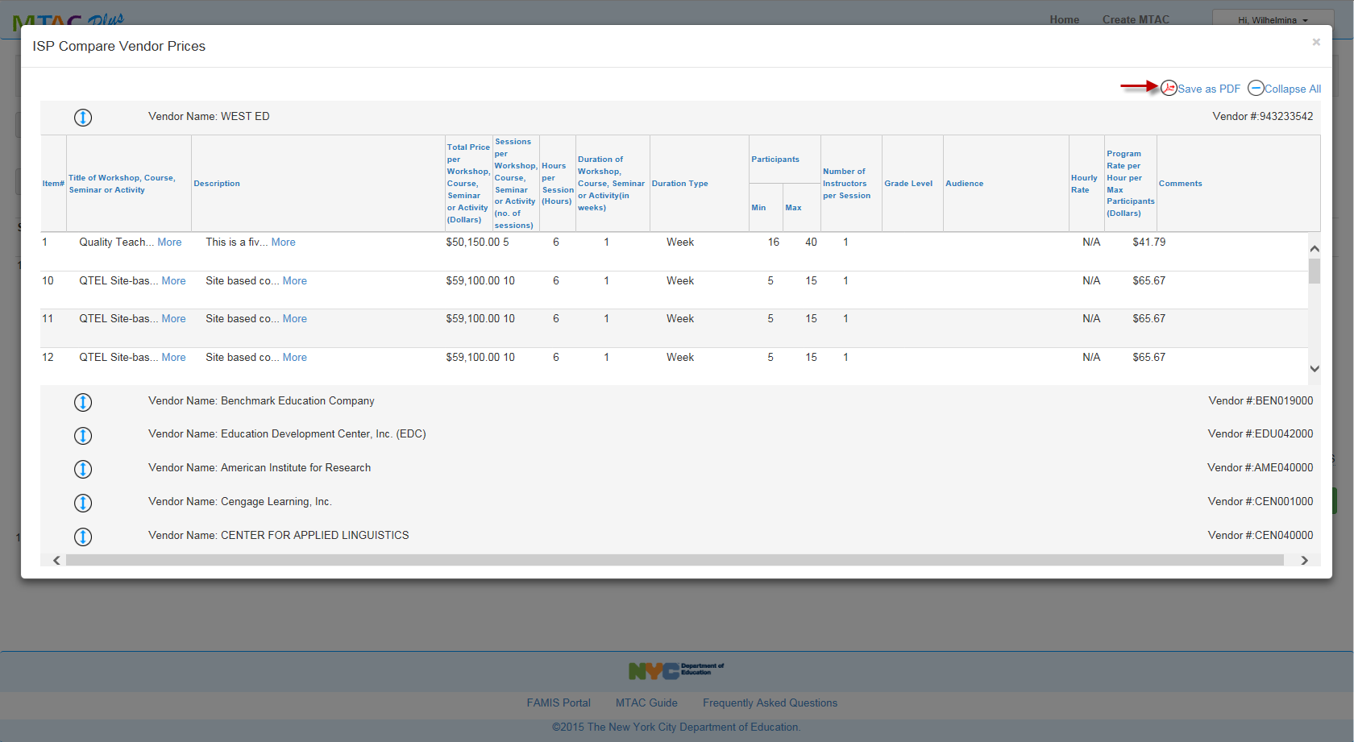
You can also click on “Save as PDF” if you want to print all the price forms for all the vendors per component chosen.

Slide 29
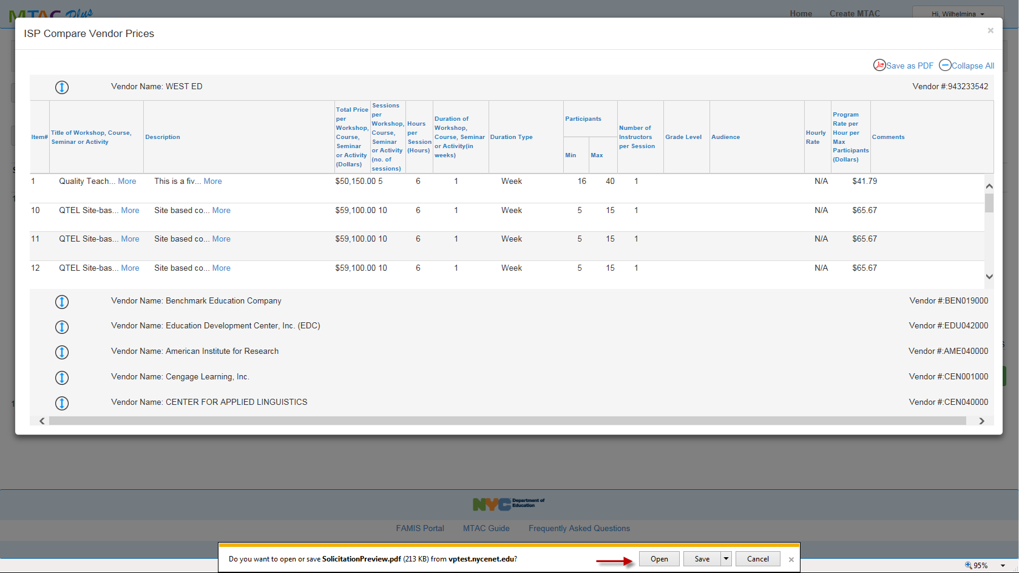
You can also download and save the price forms.

Slide 30
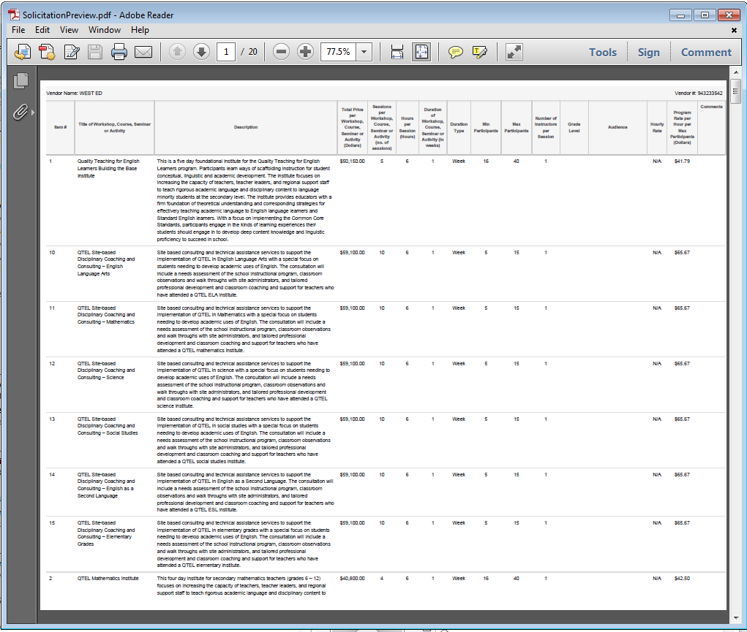
Here’s a sample of the PDF file.

Slide 31
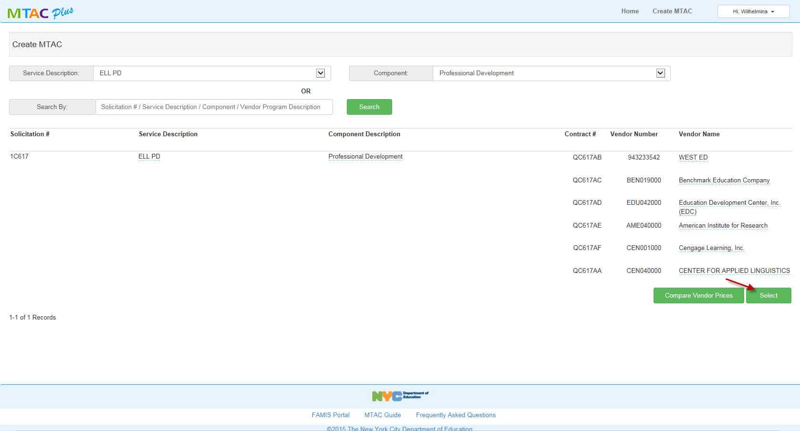
Now that we have viewed/compared vendor prices, we can proceed with our task request by clicking on the “Select” button.

Slide 32
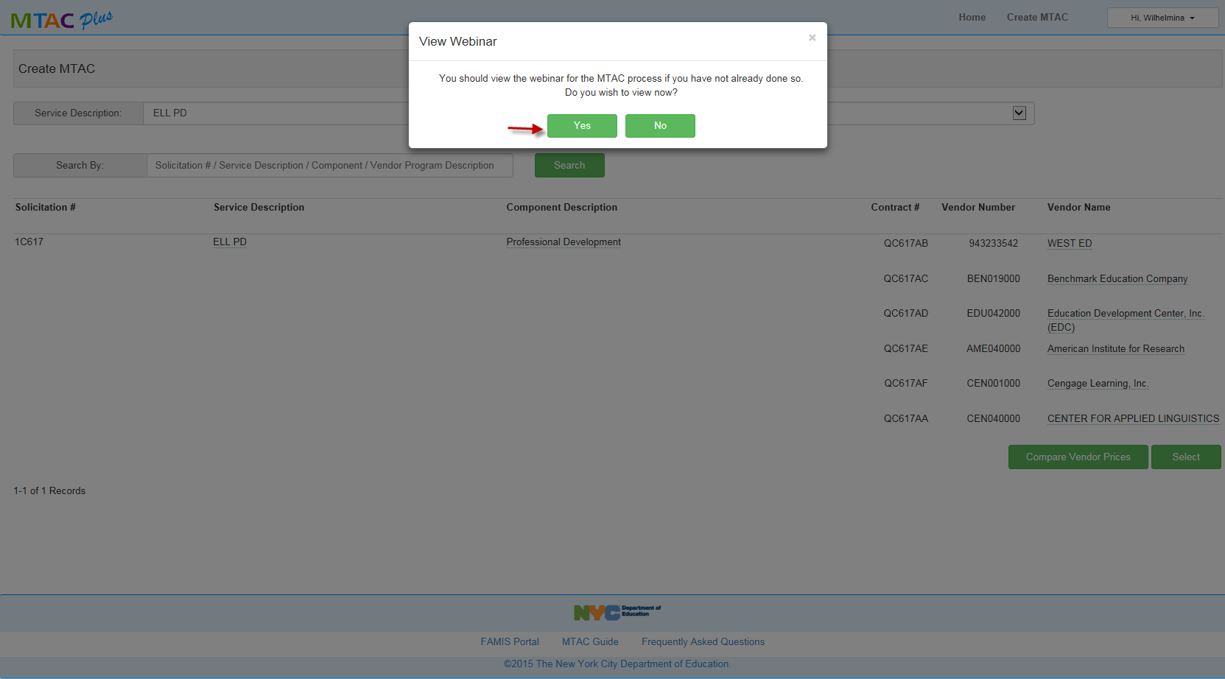
You will be asked if you want to view the webinar. If you opt for Yes, it will take you to the webinar site.

Slide 33
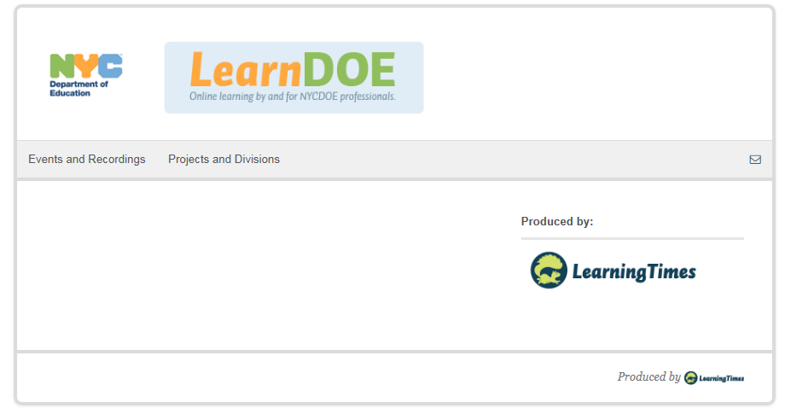
Here’s a screen shot of the webinar site.

Slide 34
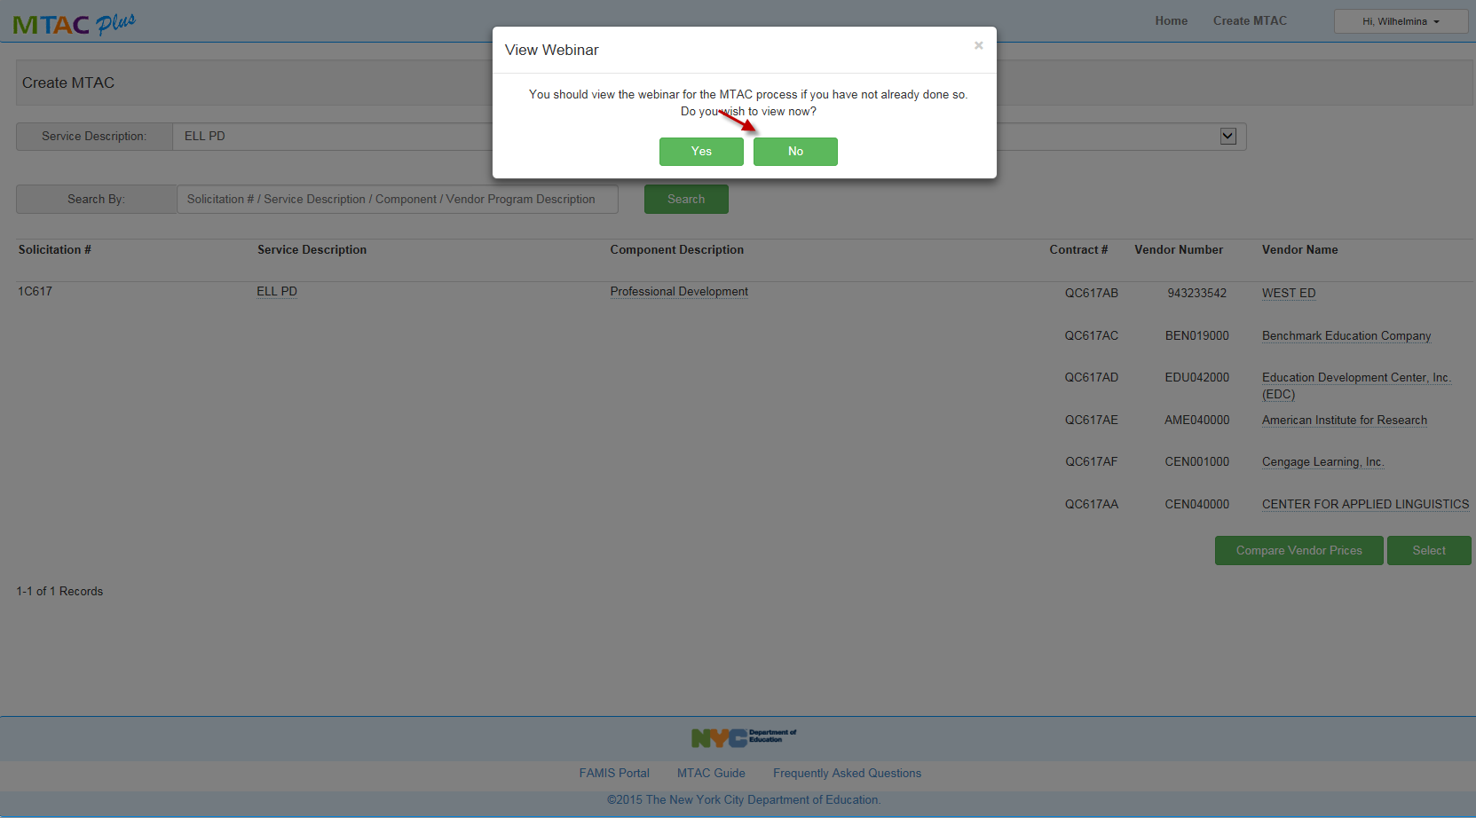
If you opt for “No”, it will take you to the next step.

Slide 35
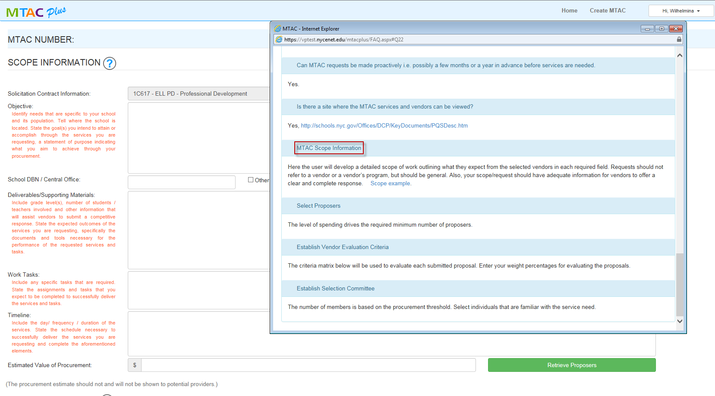
We can now create the scope for the task request by completing the required fields. You can click on if you wish to obtain further information on the specific area as shown in here.

Slide 36
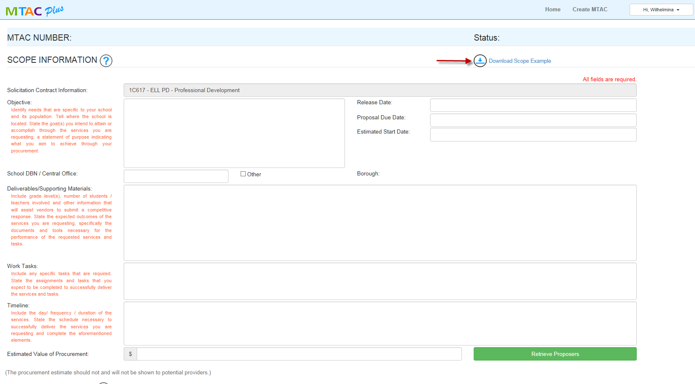
Click on “Download Scope Example” to view sample scope.

Slide 37
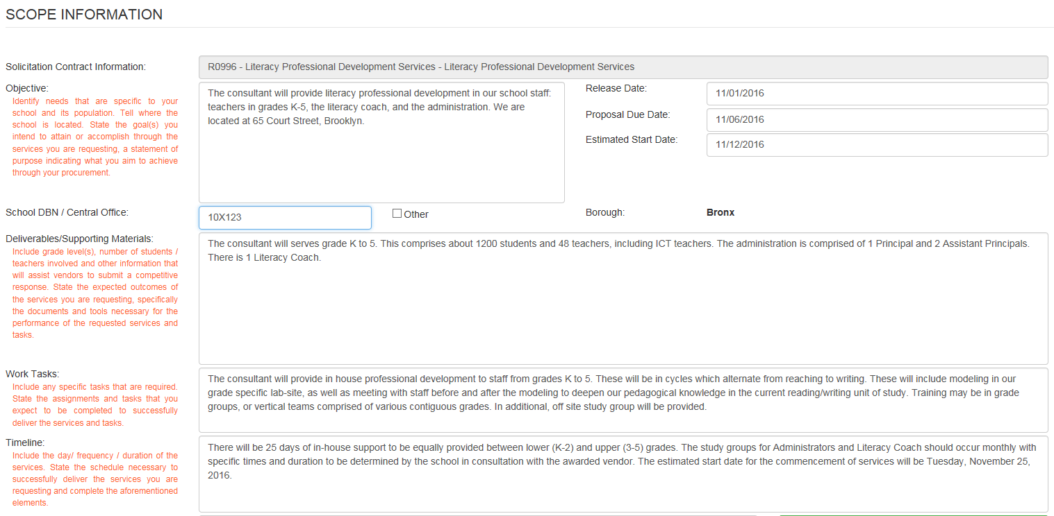
Here’s a sample scope.

Slide 38
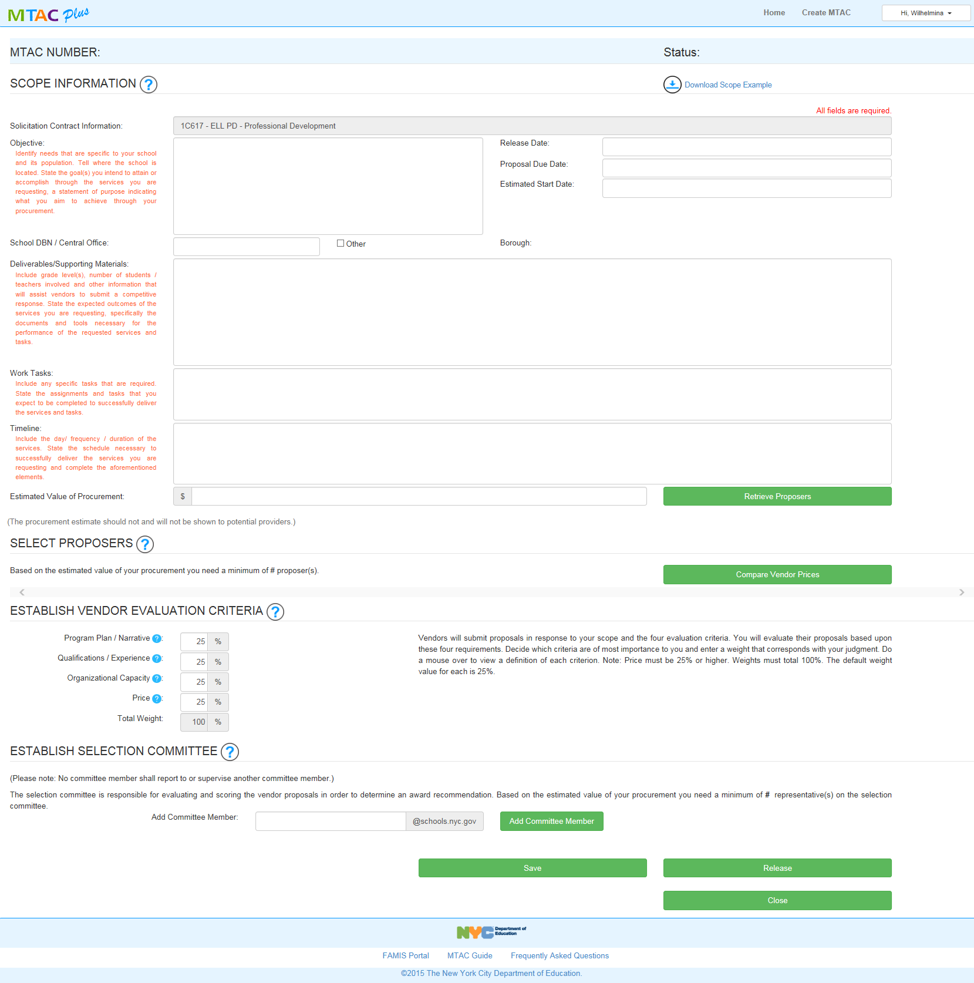
Task request page will be populated as one page from scope to selecting proposers and evaluation committee. We will discuss each section separately in the following slides.

Slide 39
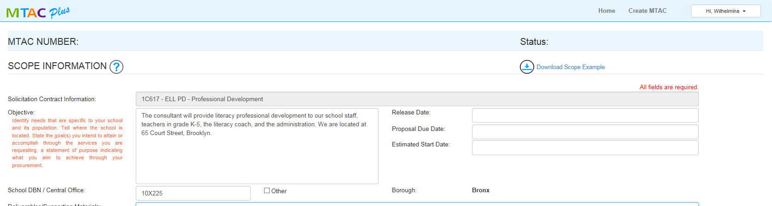
Let’s complete our scope information. Let’s begin with the “Objective” field followed by the School location code.

Slide 40
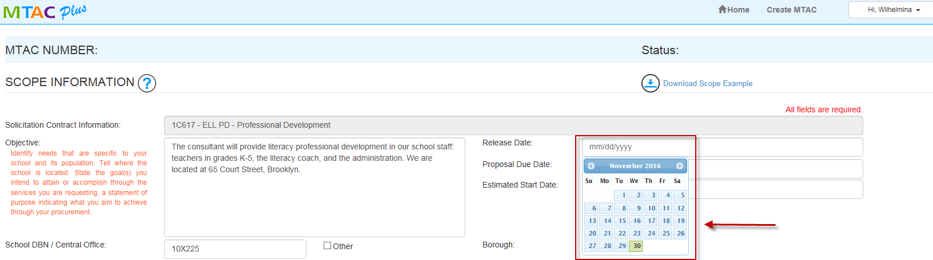
The calendar tool is available for all date selection: “Release Date”, “Proposal Due Date”, and “Estimated Start Date”.

Slide 41
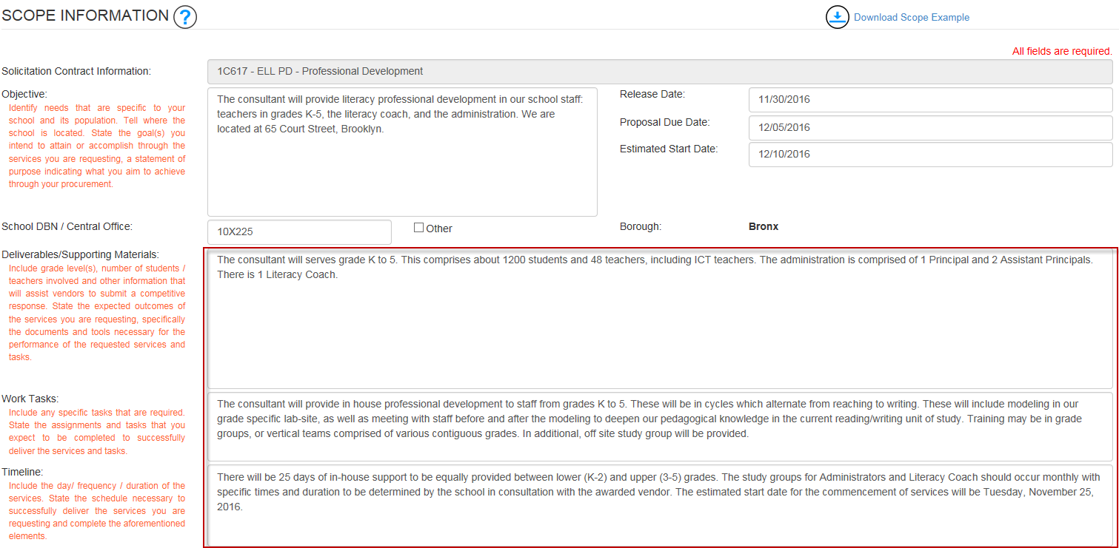
To complete our scope information, fill out the following fields” “Deliverable”, “Work Tasks” and “Timeline”.

Slide 42
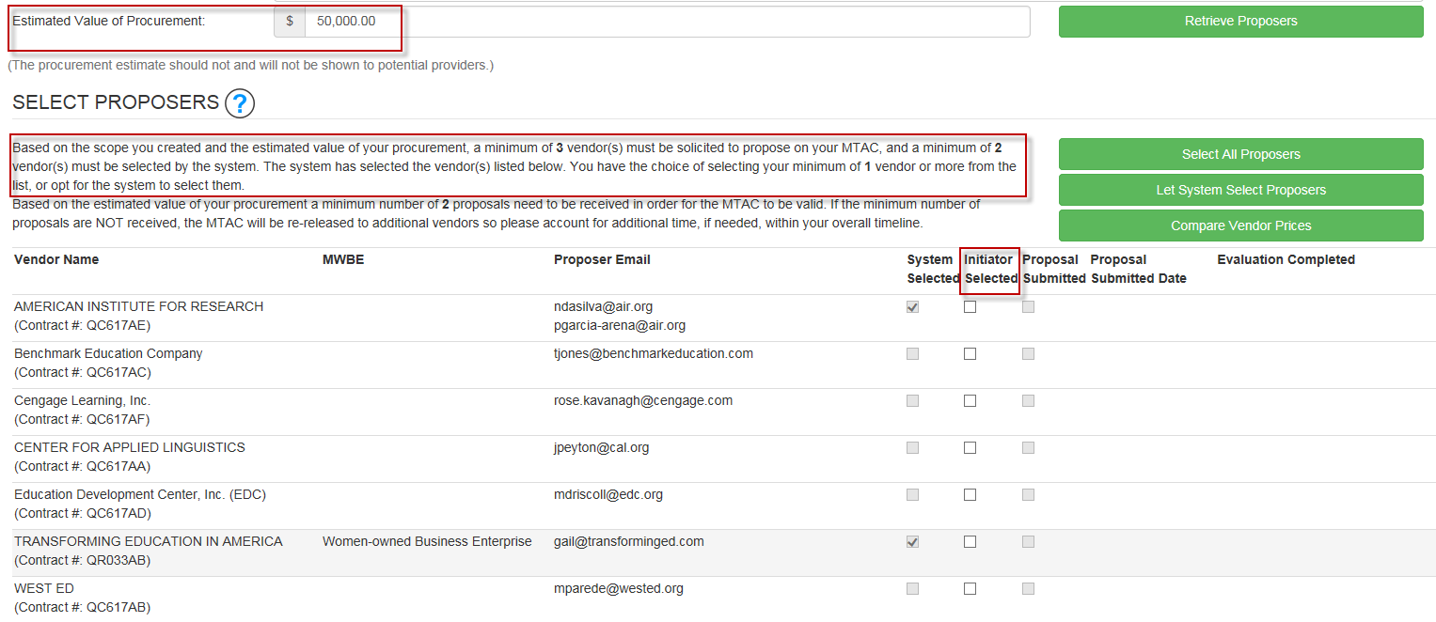
The next section is “Select Proposers”. The procurement threshold dictates the required minimum # of proposers. We will enter $50,000 for our example here which requires a minimum of 3 vendors. The system will automatically select 2 from the list and the school will have the option to select their required minimum number of 1 vendor or more from the list. School can also opt to select all proposers by clicking on “Select All Proposers”.

Slide 43
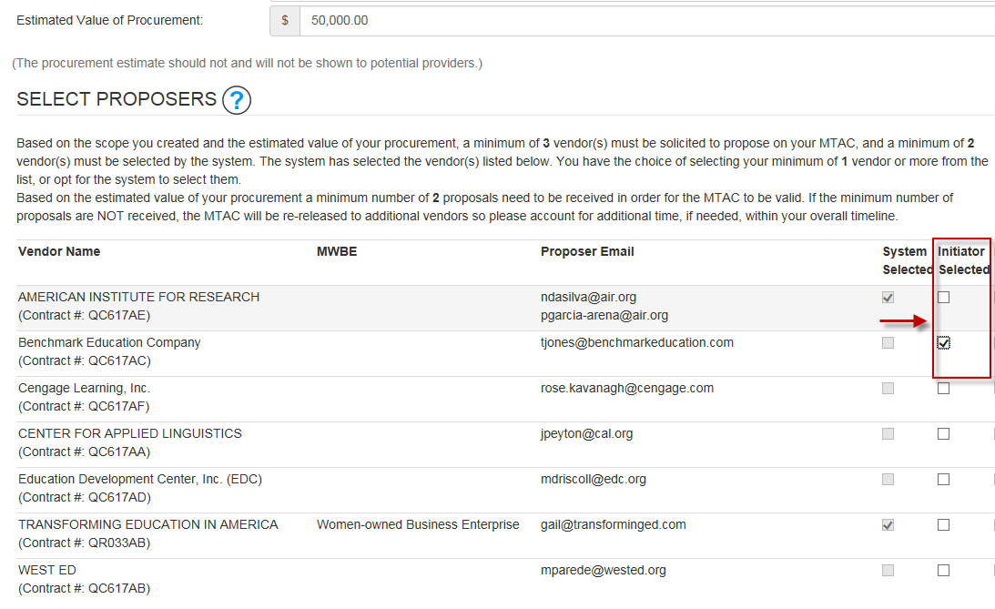
Click on the box per column “ Initiator Selected” for your remaining proposer(s). We have selected Benchmark.

Slide 44
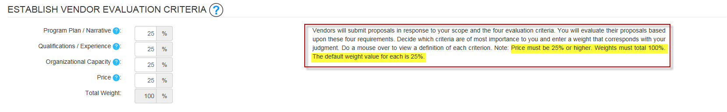
Now we can establish the weights for each criteria as shown in here. Our sample provides a 25% weight for each criteria. Please note that the price must be 25% or higher. The weights must total 100%.

Slide 45
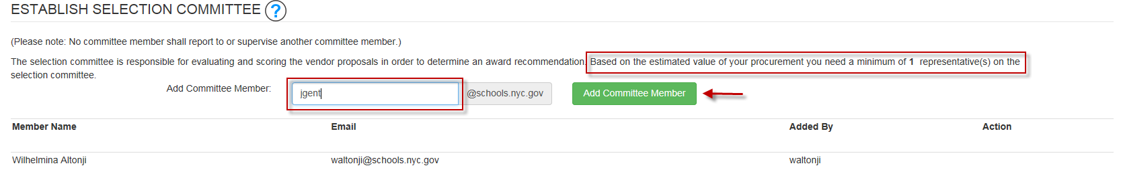
Let’s proceed with selecting the evaluation committee. The procurement threshold dictates the required minimum # of evaluators. Since our procurement amount is $50,000, the minimum is 1 evaluator. Enter the email address and click on “Add Committee Member” button.

Slide 46
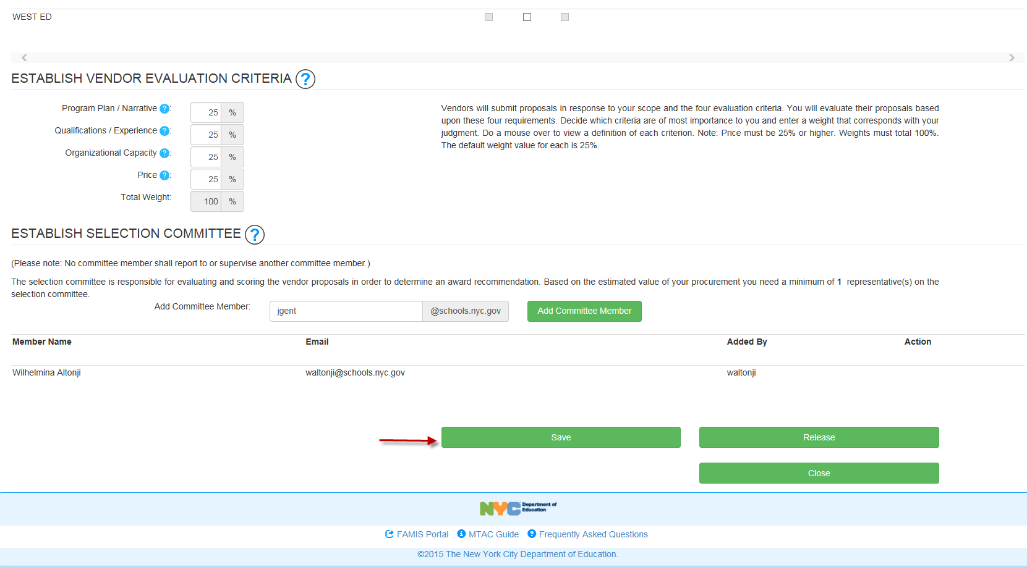
It is highly recommended that you save prior to release to ensure that all information you have entered is correct and complete. While on saved mode, you can revise your scope or any other information.

Slide 47
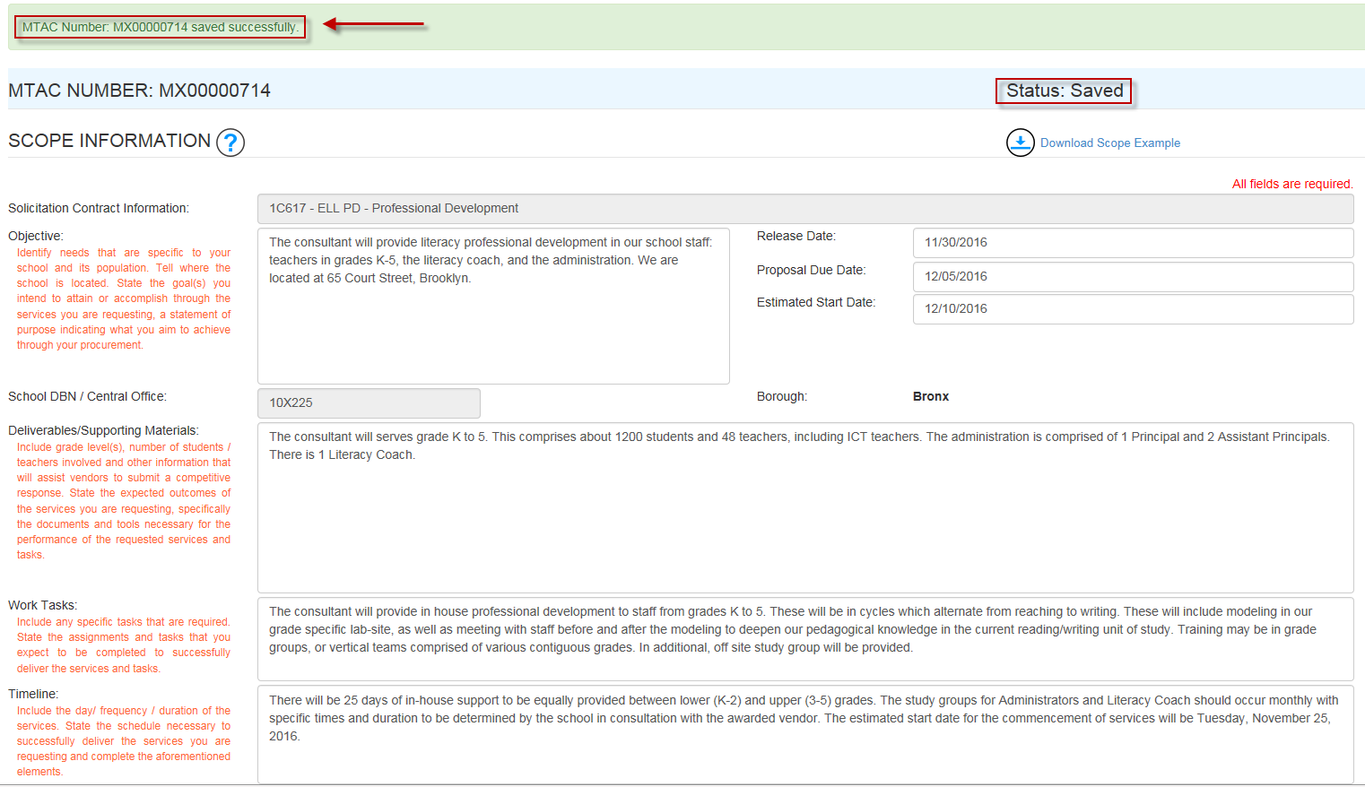
Once you click on “Save”, a confirmation message will appear.

Slide 48
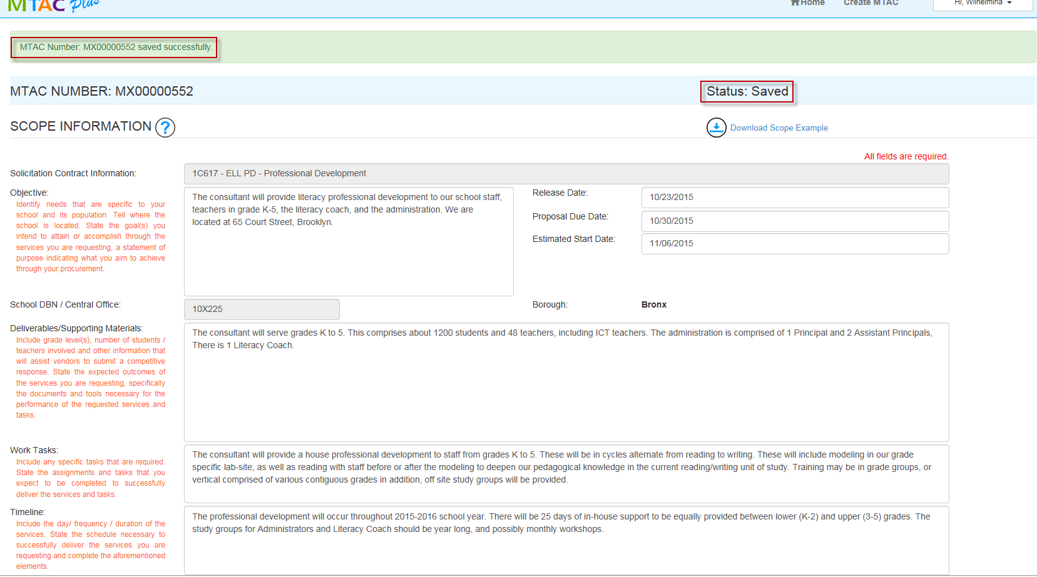
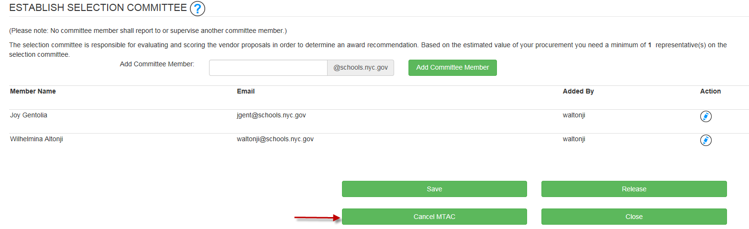
You may cancel your task request provided you have not yet released it.

Slide 49
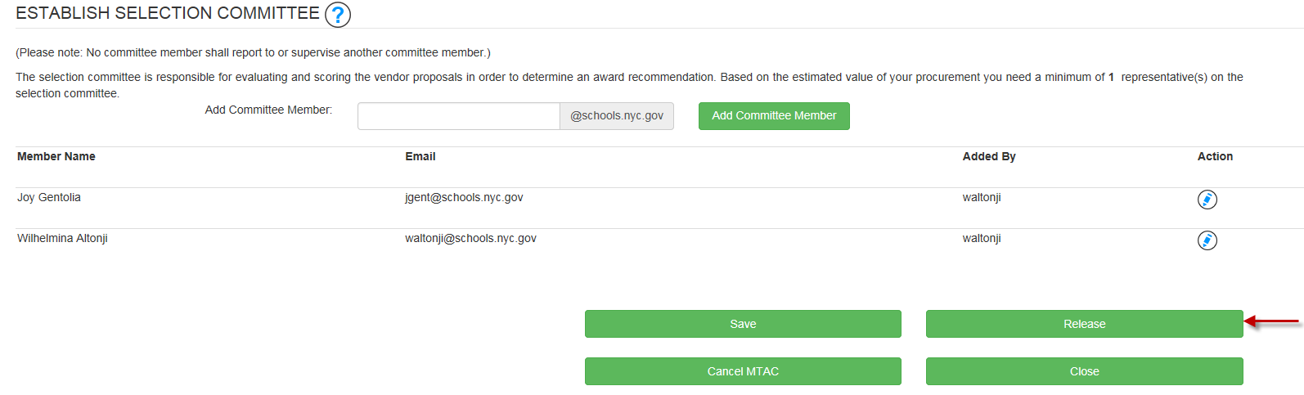
Click on “Release” to send your task request to the selected proposers. Please note that if there are fields not completed or incorrect entries, an error message will appear as a reminder for the initiator to correct and complete.

Slide 50
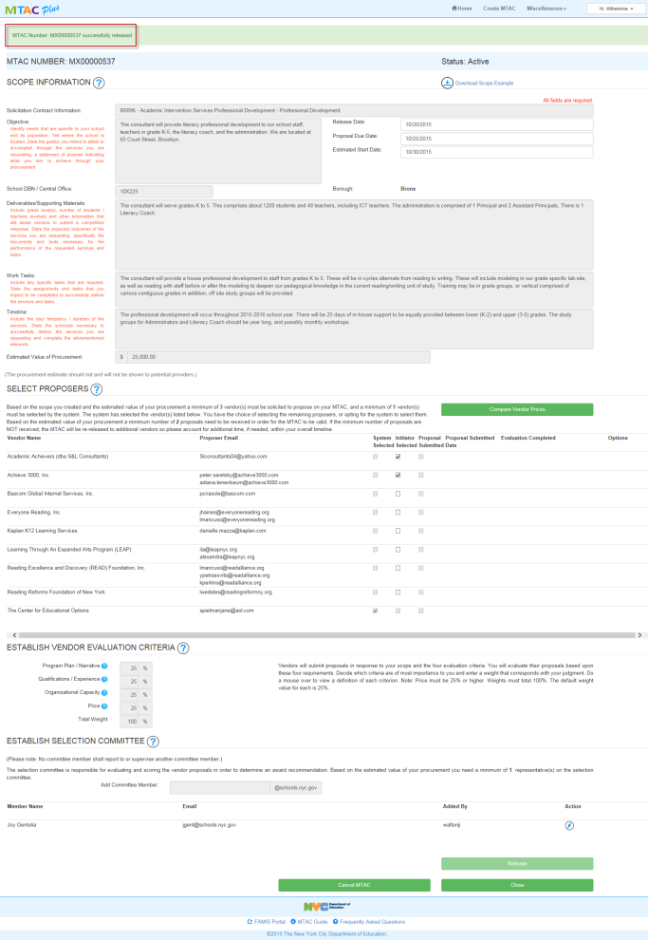
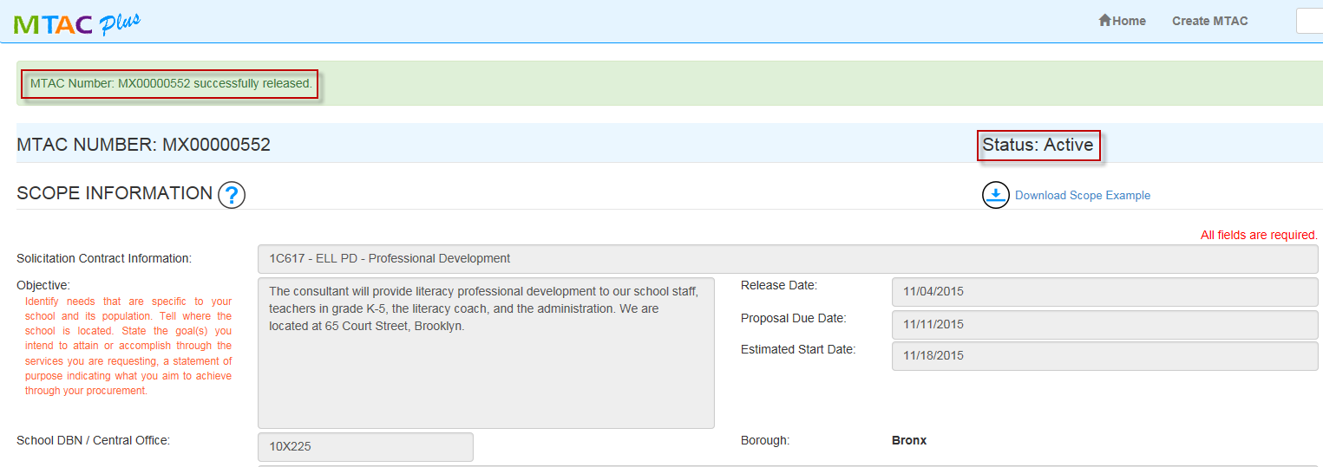
When you click on “Release”, the one page completed task request will be populated. A confirmation that it has been successfully released will be displayed on top of the page.

Slide 51
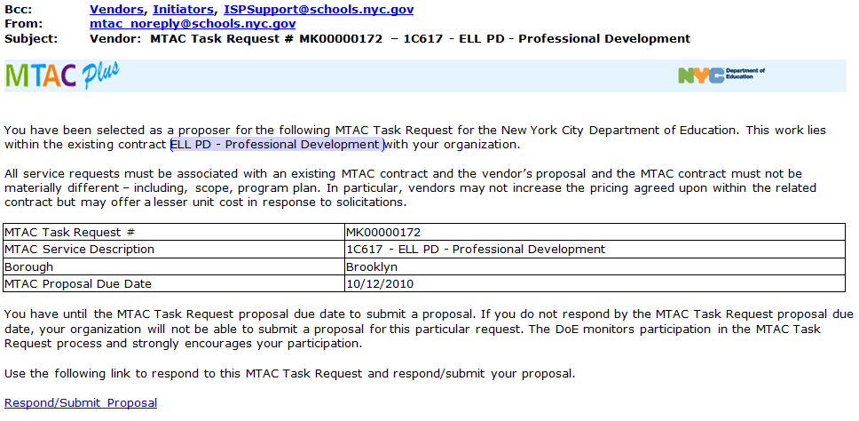
Released Email Notification
Here’s a sample email sent to the prospective proposers. A copy will also be sent to the initiator as an FYI only.

Slide 52
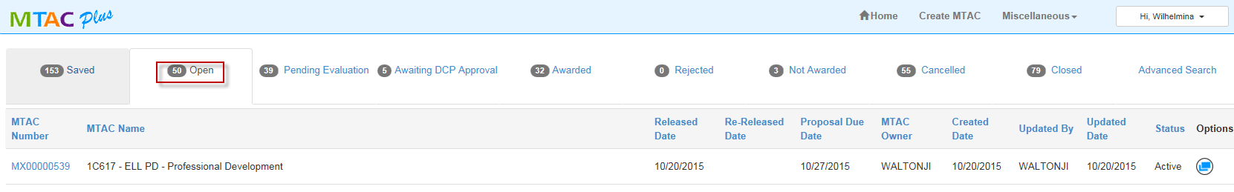
Once you have successfully released the task request, it will appear in your “Open” status tab from the landing page.

Slide 53
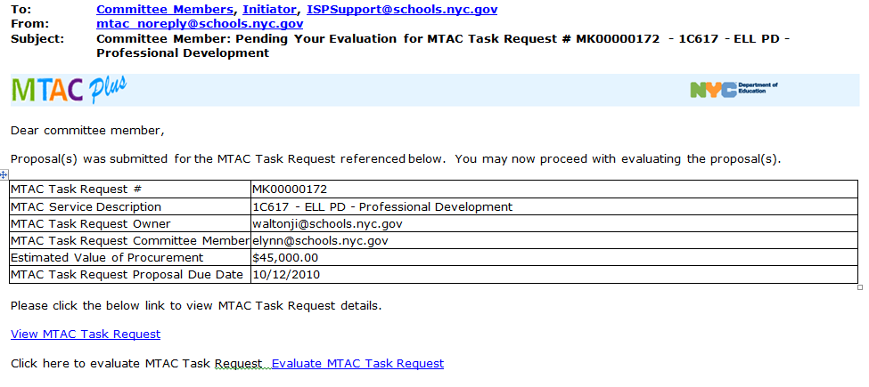
Pending Evaluation
After the Proposal Due Date, the committee will receive this email notification informing them that they can proceed with the evaluation process.

Slide 54
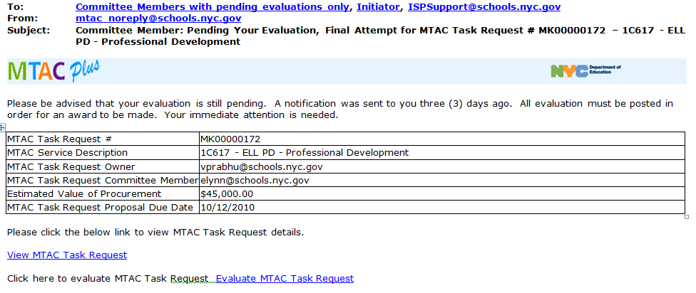
Pending Evaluation After 3 Days from the Proposal Due Date
A second reminder will be sent to the committee after three days if they still have not completed the evaluation process.

Slide 55
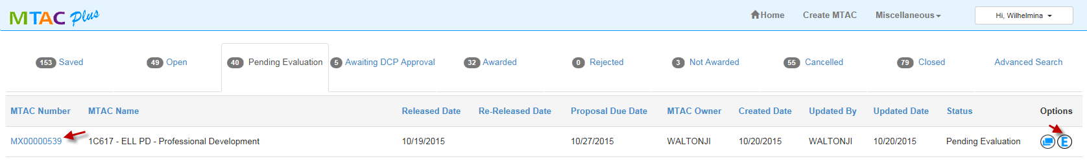
Evaluate Proposals
Upon email notification, evaluators will click on the link provided in the email and it will take them directly to the tool. They can click on the task request number or icon.

Slide 56
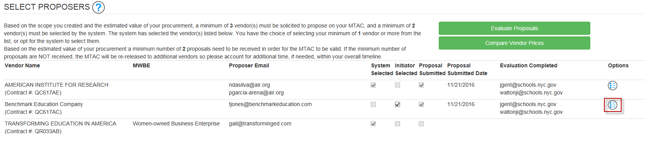
View Proposals/Scores
The evaluator will be taken to this page showing all the vendors that have responded. Our example provides two responses, one from American Institute for Research and one from Benchmark Education Company. The evaluator can view the proposals by clicking on

Slide 57
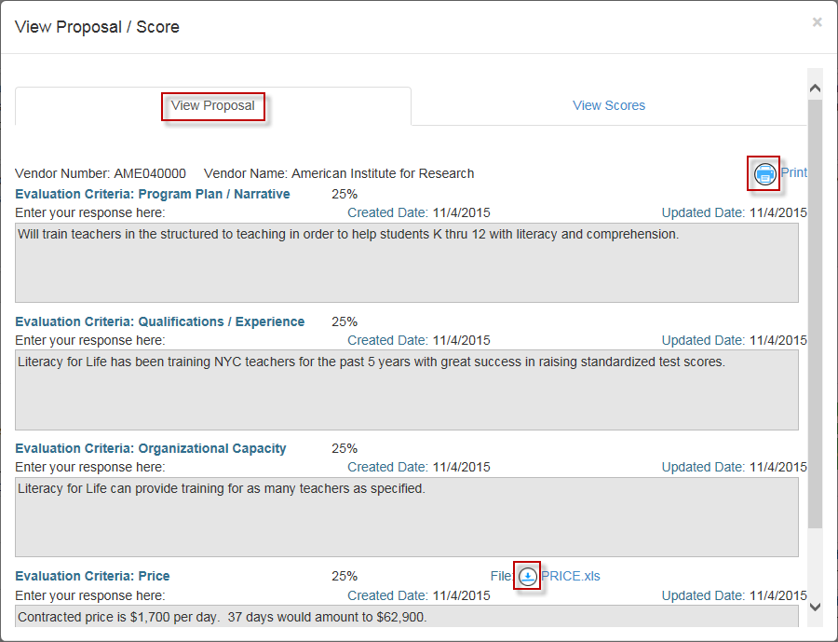
This is a sample of a vendor proposal. The evaluator will have the option to print the response or uploaded files submitted by the vendor.

Slide 58

Proceed to “Evaluate Proposals” by clicking on the button.

Slide 59

The evaluator will enter the scores per criteria, 1 as the lowest and 10 the highest. While doing this, the evaluator will continue to have access to view the vendor responses as highlighted in this page. The evaluator will then click on “Submit Score”.

Slide 60

Once you have entered your scores for all the vendors, click on “Confirm Scores” to complete your evaluation.

Slide 61

A confirmation will be displayed on top of the page that you have completed your scores.

Slide 62

Request for Final Procurement Amount
Once all committee members have posted their scores, the initiator will receive an email notification indicating the selected vendor. The initiator will be required to confirm the final procurement amount by clicking on the link.

Slide 63

Request for Final Procurement Amount
The initiator can click on the icon to enter the final procurement amount.

Slide 64

This is a sample page where the initiator will enter the final procurement amount and then click “ Update Final Procurement”.

Slide 65

On the same page where the initiator has confirmed the final procurement amount, the selected vendor is indicated by the icon and is shaded.

Slide 66


Final Procurement Amount has been updated.

Slide 67

Awarded + Final Procurement Amount Confirmed
This is a sample email notification for the selected vendor. The initiator will receive a copy of the email.

Slide 68

Awarded + Final Procurement Amount Confirmed
(Not Selected Proposals)
This is the sample email for the vendors who were not selected.

Slide 69

Awaiting DCP Approval
For procurements $250K and over, additional approval will be required.

Slide 70

This is a sample email for the initiator and approver.

Slide 71

Note – to view Task Requests from the old MTAC tool, click on the “View Old MTAC” to bring you to the old application. New task requests are to be created via MTAC Plus.

Slide 72
Sample Task Request with Errors

Slide 73


The task request named a specific vendor which is not allowed. The task request should be open to ensure a competitive process among the contracted vendors eligible to provide the service.

Slide 74

Date validation. Release date should be greater or equal than today.

Slide 75

Date validation. Proposal due date must be at least 5 calendar days from the release date.

Slide 76

Date validation. The estimated start date must be at least 5 calendar days from the proposal due date.

Slide 77

The required minimum number of proposers was not posted.

Slide 78

Price Criteria must be 25% or higher.

Slide 79

The required minimum number of committee members was not posted. The initiator will not be counted towards the minimum required minimum number.

Slide 80
Resources
  MTAC Plus Webcast Recording
  http://www.learndoe.org/dfsbo/recording-mtac-schools/
  Finance Service Center
  clientservices@schools.nyc.gov
  718-935-5000

